Slide 1
Vibhaag Web App
A college analytics, session monitoring and
management tool
By,
Sudhanva N
PES1201702260
Karthik D
PES1201702449
Harsha K Y
PES1201801839
Guide:
Dr Veena S,
Chairperson,
Department of Computer
Applications

Slide 2
Abstract
The application consists of two components
The mobile application for end users that acts as a companion and authentication tool
The web application which helps monitor and manage the activities of the college
It records the time, date and location of the incident by a QR Code and sends the data securely to the web application

Slide 3
Key Features
Custom time table for every batch and for every session
Faculties can confirm the class conduction using mobile apps with timings
Meaningful insights such as daily and weekly abstracts can be generated
Admins have the ability to change the time table and re-allocate faculties as per requirement

Slide 4
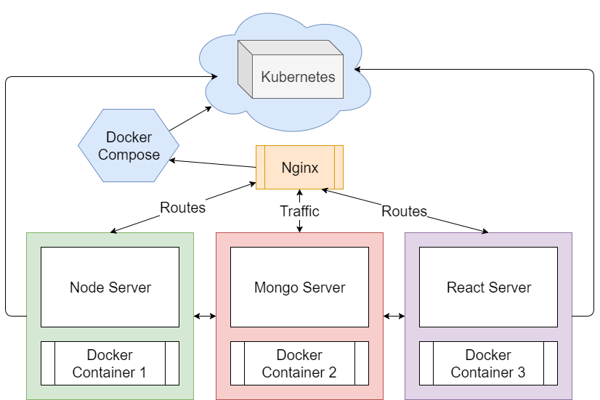
Planned
Architecture

Slide 5
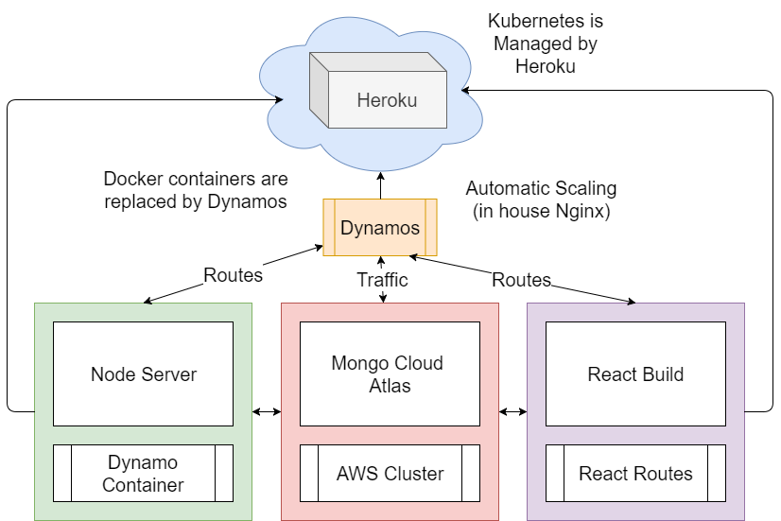
Implemented
Architecture

Slide 6
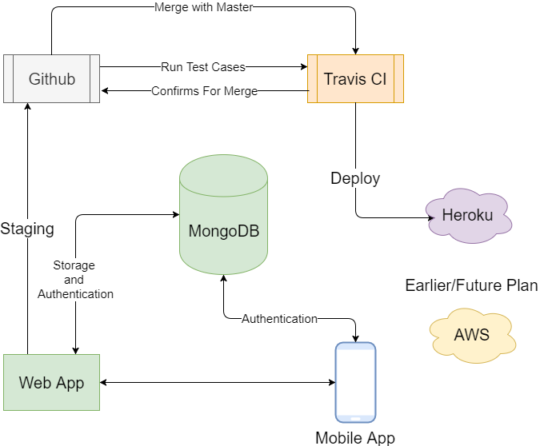
Data Flow

Slide 7
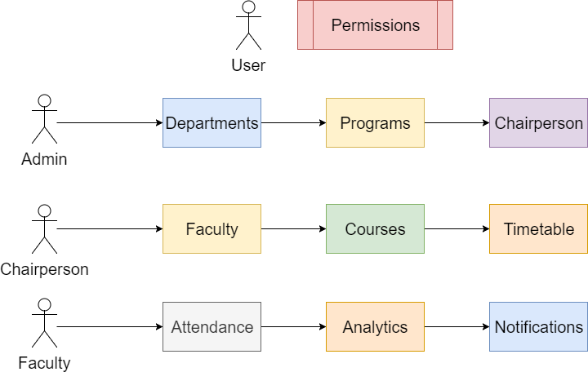
Use Cases

Slide 8
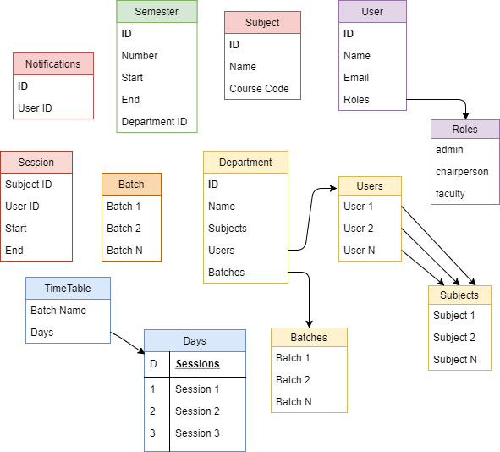
Database
Structure

Slide 9
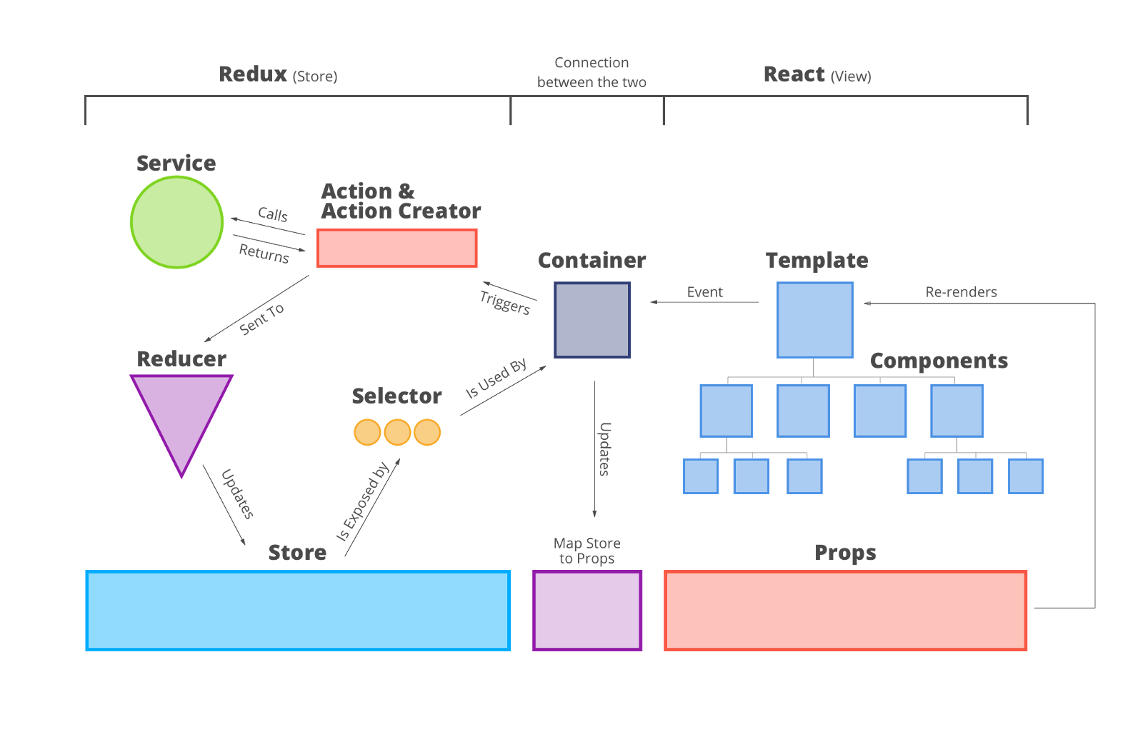
App
Bindings

Slide 10
What Has Been Done So Far
Routes setup for React, Redux and Node
Authentication using JSON Web Token
Backend with Frontend Setup for Development
Continuous Integration – Mocha, Coffee, Travis CI
Continuous Delivery – Github, Travis CI, Heroku

Slide 11
Demo

Slide 12
What Needs To Be Done
Working with Mobile Apps
API endpoint restructuring for Mobile Apps
Test cases for continuous integration
Backend with Frontend Setup for Production
Background jobs and scheduling

